Slide 1
NYC Restaurant Inspection Data Analysis
IST 652 Scripting for Data Analysis
Abhijith Anil Vamadev

Slide 2
Data
"DOHMH_New_York_City_Restaurant_Inspection_Results.csv
https://data.cityofnewyork.us/Health/DOHMH-New-York-City-Restaurant-Inspection-Results/43nn-pn8j
Libraries used: Pandas, seaborn, matplotlib, wordcloud, plotly, nltk, re
26 variables with 23,000 data points
Identify the 5 most common cuisine types available in NYC
Identify the restaurants on a map, by using geographical coordinates for different Boroughs and Grade
Find the difference between A, B and C grade level violation description

Slide 3
Data Preprocessing
Dropped Columns:
Too many NA/Null Values
Did not provide any insight into the analysis
Changed column names as many column names had spaces in them:
CUISINE DESCRIPTION cuisine_description
Dropped duplicates by using the “Name” column as a unique identifier.
Dropped Null values present in Grade, Latitude, Longitude and Violation Description
26 variables with 23,000 data points
12 columns with 10,000 data points

Slide 4
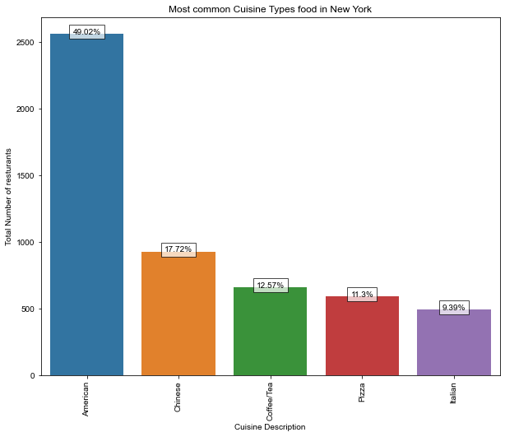
Identify the 5 most common cuisine types available in NYC
Cuisine Description | Total Restaurants in NY
American | 2559
Chinese | 925
Coffee/Tea | 656
Pizza | 590
Italian | 490

Slide 5
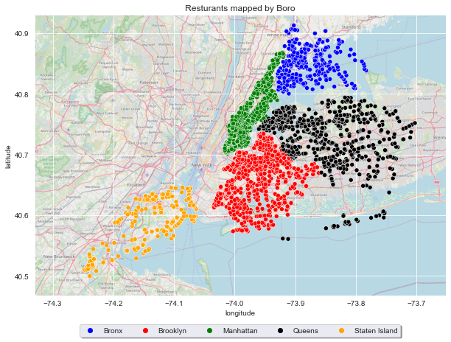
Identify restaurants in a map by using geographical coordinates for different Boroughs
Boroughs | Total Restaurants in NY
Manhattan | 1958
Brooklyn | 1242
Queens | 948
Bronx | 364
Staten Island | 244

Slide 6
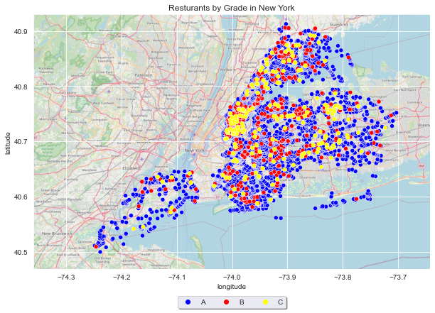
Identify restaurants in a map by using geographical coordinates for different restaurant GRADES
Grades | Total Restaurants in NY
A | 8207
B | 512
C | 204

Slide 7
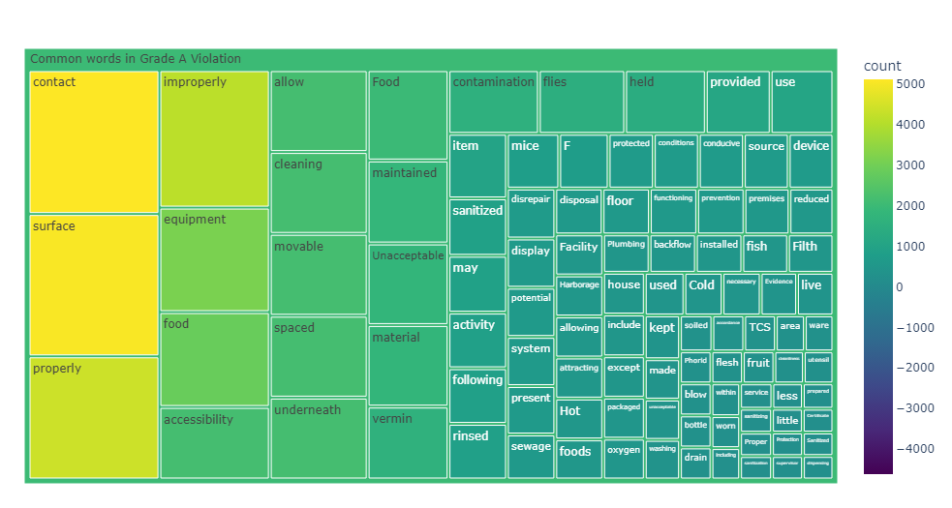
Most Common Words Found in Grade A violation Description

Slide 8
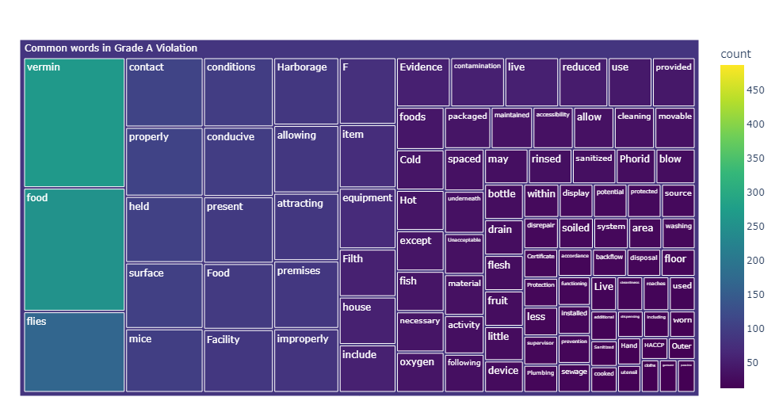
Most Common Words Found in Grade B violation Description

Slide 9
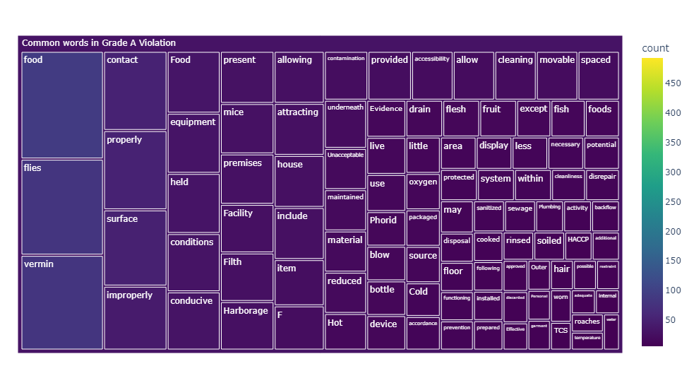
Most Common Words Found in Grade C violation Description

Slide 10
Conclusion
The most common type of cuisines available in NYC are:
American, Chinese, Coffee/Tea, Pizza, Italian
Manhattan has the most number of restaurants in NYC and there are 8407 GRADE A restaurants, with Staten Island having the lowest number of GRADE C restaurants.
There are differences in wording for the different GRADES violation descriptions:
Grade A - Contact, Surface, Properly. Improperly, equipment, food
Grade B - Vermin, Food, Flies, properly, contact, mice
Grade C - Food, Flies, Vermin, Contact, properly, improperly, hair etc.
With the new information gained, can avoid the Grade C restaurants and hopefully eat better food with my next visit to New York, City.

